Slide 1
Use RMI to implement Centralized Clock Synchronization

Slide 2
Centralized Clock Synchronization
Centralized clock synchronization is a method used to ensure that multiple clocks or computers running concurrently have the same time. In this approach, a single central clock serves as the master reference, while other clocks or devices synchronize their times with it. This method is commonly used in distributed systems, networks, and embedded systems where precise timekeeping is crucial. The central clock is typically responsible for generating the time signal, and the other clocks adjust their times accordingly to maintain synchronization.
It is mechanism to sync the time of all computers in Distributed system network.
1. Physical Clock Synchronization
- UTC (Universal Time Coordinate)
- Christion's Algorithm
- Berkely Algorithm
2. Logical Clock Synchronization
- Lamport Clock Synchronization
3. Mutul Exclusion Clock Synchronization
- Lamport's algorithm
- Centroid algorithm
- distributed algorithm
- Token based algorithm.
Distributed algorithm have same properties
- The relevant information is scattered anong multiple machine
- The process make decision.
- A single point of joining in the systems should be avoided.
- No common clock of other precise global time source exists.

Slide 3
Centralized Clock Synchronization
Centralized:-
Time is unambiguous. Centralized is the one in which a time server is used as a reference. The single time server propagates its time to the nodes and all the nodes adjust the time accordingly. It is dependent on single time server so it that node fails, the whole system will lose synchronization. Examples of centralized are
- Berkeley Algorithm
- Passive Time Server
- Active Time Server.
-same Shared memory + Event ordering is clean based all events are timed by the same clock.
Distributed:
Time is ambiguous: Distributed is the one n which there is no centralized time server present, Instead the nodes adjust their time by using their local time and then, taking the average of the differences of time with other nodes. Distributed algorithm overcome the issue of centralized algorithm like he scalability and single point failure.
Examples of distributed algorithms are
- Global Averaging algorithm
- Localized Averaging Algorithm
- NTP (Network time protocol,
--Individual nodes Shared memory + Event ordering is clean based all events are timed by the individual nodes clock. (It means no shared memory and no same clock)

Slide 4
Development method:
Requirement – Use RMI to implement Centralized Clock Synchronization
Specification:
2. Design – High level design, detailed level design.
3.Coding/Build/Implement
Used Python library PyPro5 to communicate between client and Server. The Build is in Window platform and console-based applications.
4. Testing
Used Unit testing approach such as input data and expected output for each method.
5. Go Live
There are installable instructions to run the client and server in same machine or different machine.

Slide 5
Agile Development method:
Requirement – Implement Use case stories/Use case diagram
Actor: End user
functionalities:- End user request from server using the client interface on Window console application.
2. Design :- Implement Sequence diagram, Class diagram, component diagram
There are two interface one for server and second for client. Similarly, there are two classed one for server and second for client.
3. Coding/Build/Implement – Implement class diagram into the pseudo code. Used Python library and code to implement the RMI Suzuki kasami algorithm
4. Testing – Implement test cases such as unit test cases, integration test cases, golive test, user test.
5. Go Live – Implement component diagram and use case diagram.

Slide 6
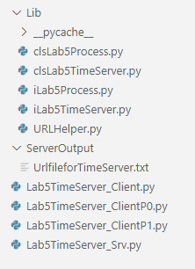
Components:
1. TimeServer Interface: This interface defines methods for processes to interact with the time server. Methods
can include:
• getTime(): Retrieves the current time from the server.
• register(process) (optional): Registers a process with the server (useful for tracking connected clients).
Response:-
Used Python based code to implement.
File name: iLab5TimeServer.py

Slide 7
Components:
2 TimeServer Implementation: This class implements the TimeServer interface. It maintains:
• The system's reference clock.
• A list of registered processes (optional, for monitoring).
• It implements methods from the interface:
o getTime(): Returns the current time from the server's reference clock.
o register(process) (optional): Adds the process to the list of registered clients
Response:-
Used Python based code to implement.
File name: clsLab5TimeServer.py

Slide 8
Components:
3. Process Interface: This interface defines methods for processes to synchronize their clocks. Methods can
include:
synchronize(): Requests the current time from the time server
Response:-
Used Python based code to implement.
File name: iLab5Process.py

Slide 9
Components:
4. Process Implementation: This class implements the Process interface. It maintains:
• A local clock.
• A reference to the TimeServer object.
• It implements methods from the interface:
o synchronize(): Uses RMI to call getTime() on the TimeServer.
▪ Adjusts the local clock based on the received time and a calculated offset (explained
later)
Response:-
Used Python based code to implement.
File name: clsLab5Process.py

Slide 10
Interface:iLab5Process
synchronize()
Class : myLab5Process
synchronize()
Interface:iLab5TimeServer
Gettime()
Register()
Class : myLab5TimeServer
Gettime()
Register()

Slide 11
Implementation Steps:
Develop the interfaces and classes mentioned above.
Implemented using Python.
2. Implement RMI functionalities:
• Use UnicastRemoteObject to create remote objects for TimeServer and Process.
• Use the Naming class to register the TimeServer object on the RMI registry.
Response:
Used Python library and framework Pyro5 to create UnicastRemoteobject for TimeServer and Process.
Server Setup:
Start the TimeServer on a designated machine to act as the central time source.
3. Process Logic:
Each process creates its own Process object and references the remote TimeServer object.
Implemented in Lab5TimeServer_Srv.py.
• Processes can periodically call synchronize() to adjust their local clocks.
Implemented in Lab5TimeServer_Client.py

Slide 12
Implementation Steps:
• Upon calling synchronize():
o The process retrieves the current time from the server using RMI.
o It calculates the time difference (offset) between the received time and its local clock.
o It adjusts the local clock by applying a correction factor based on the offset.
.
Implemented in Lab5TimeServer_Client.py and method
o It adjusts the local clock by applying a correction factor based on the offset.
▪ This correction factor might involve averaging multiple samples or using more
sophisticated algorithms (e.g., Kalman Filter) to account for network delays and clock
Drift
Kalman Filter: https://filterpy.readthedocs.io/en/latest/kalman/KalmanFilter.html

Slide 13
Benefits:
• Simple and centralized: Easy to implement and manage with a single time source.
Scalability: Can handle a moderate number of clients efficiently.
Implemented in in Lab5TimeServer_Client.py and in Lab5TimeServer_srv.py
Pyro5.api
time
numpy as np
filterpy.kalman
import KalmanFilter

Slide 14
Limitations:
Single point of failure: The time server is a critical point of failure. If it fails, all processes lose synchronization.
Response:-
Used Python based code to trace performance and availability of time Server exitance. It is client – server-based implementations on windows platform. Performance is good.
Network latency: Network delays can introduce inaccuracies in clock adjustments.
Response:-
Used Python library and framework to manage the network latency.
User will have proper protocol and recommended practice on windows OS to install pypro5 library and python to run the modules of server and clients. So, Message overhead handles properly with Python code.
Scalability limitations: Performance might degrade with a large number of clients due to server load.
Response:-
Window OS with python handles large number of process and performance is good.
Notes:
Limitations:
• Scalability limitations: Performance might degrade with a large number of clients due to server load.

Slide 15
Additional Notes:
This is a high-level overview. The actual implementation will involve exception handling,
Response:-
Used try, except and finally block to handle exception. Implemented using Python try .. block
Used user based natural language English with proper function name to provide proper information.
e.g.
try:
#getting samples for server time.
samples = [self.time_server.getTime() for _ in range(5)]
#calcuate average server time
average_server_time = sum(samples) / len(samples)
#calcuate offset
offset = average_server_time - self.local_clock
# Kalman Filter update
self.kf.predict()
self.kf.update(offset)
corrected_offset = self.kf.x[0][0]
self.local_clock += corrected_offset
print(f"Synchronized local clock: {self.local_clock}")
print(f"Process {self.MyProcessName}: Local clock adjusted by {corrected_offset} seconds.")
except Exception as error:
print(f" Error from clsLab5Process synchronize function : {error}")
print(f"clsLab5Process synchronize function finished for Process : {self.MyProcessName} ")
Notes:
This is a high-level overview. The actual implementation will involve exception handling, serialization of

Slide 16
Additional Notes:
serialization of objects for RMI communication, and handling potential clock skews.
Serialization, also known as marshaling, is the process of translating a piece of data into an interim representation that’s suitable for transmission through a network or persistent storage on a medium like an optical disk. Because the serialized form isn’t useful on its own, you’ll eventually want to restore the original data. The inverse operation, which can occur on a remote machine, is called deserialization or unmarshaling.
Python ships with the following modules in the standard library, which provide binary data serialization formats for different purposes:
pickle: Python object serialization
marshal: Internal object serialization
shelve: Python object persistence
dbm: An interface to Unix databases
Notes:
objects for RMI communication, and handling potential clock skews.

Slide 17
Additional Notes:
Thread synchronization for concurrent access to queues and sequence numbers.
Used Multithreading based python library to thread synchronization. Thread.join method used to synchronization of thread.
As we know we are using window OS based threads to communicate between client and servers. Server will create threads when request will come from client and destroy thread when client request finished.
The server thread synchronizes with windows OS thread for access local memory and IO operations with main processors.
We have used Threading.lock method when process access Critical section and release lock when exit from the critical section.

Slide 18
Additional Notes:
Consider using existing RMI libraries and frameworks for easier implementation.
Response:--
Implemented with Python on window OS. As we have used python library and python tools such as pypro5 library and python compiler, loader, assembler and runner to execute the server in one process and client to execute in multiple process. So we have used Python based RMI library and Python based frameworks to implement alogrihtm.
• Centralized synchronization is suitable for smaller systems or scenarios where simplicity is prioritized. For
larger or more critical systems, consider distributed clock synchronization algorithms like Berkeley
Algorithm or Cristian's Algorithm.
Response:-
Time is unambiguous. Centralized is the one in which a time server is used as a reference. The single time server propagates its time to the nodes and all the nodes adjust the time accordingly. It is dependent on single time server so it that node fails, the whole system wil lose synchronization. Examples of centralized are
- Berkeley Algorithm
- Passive Time Server
- Active Time Server.
-same Shared memory + Event ordering is clean based all events are timed by the same clock.
Notes:
• • Centralized synchronization is suitable for smaller systems or scenarios where simplicity is prioritized. For
larger or more critical systems, consider distributed clock synchronization algorithms like Berkeley
Algorithm or Cristian's Algorithm.

Slide 19
Additional Notes:
• Centralized synchronization is suitable for smaller systems or scenarios where simplicity is prioritized. For
larger or more critical systems, consider distributed clock synchronization algorithms like Berkeley
Algorithm or Cristian's Algorithm.
Response:-
Time is ambiguous: Distributed is the one n which there is no centralized time server present, Instead the nodes adjust their time by using their local time and then, taking the average of the differences of time with other nodes. Distributed algorithm overcome the issue of centralized algorithm like he scalability and single point failure.
Examples of distributed algorithms are
- Global Averaging algorithm
- Localized Averaging Algorithm
- NTP (Network time protocol,
--Individual nodes Shared memory + Event ordering is clean based all events are timed by the individual nodes clock. (It means no shared memory and no same clock)
Notes:
• • Centralized synchronization is suitable for smaller systems or scenarios where simplicity is prioritized. For
larger or more critical systems, consider distributed clock synchronization algorithms like Berkeley
Algorithm or Cristian's Algorithm.

Slide 20
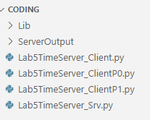
To implement BSS using RMI with Python’s Pyro library, you can follow these steps.
1. Install Pyro (pip install Pyro5) and (pip install filterpy) with admin permissions
2. Remote Process (Server) (file named Lab5process.py and Lab5TimeServer.py)
3. Client Process (file named Lab5TimeServer_Client.py)
5. Run the Server (python Lab5TimeServer_srv.py)
6. Run the Client (python Lab5TimeServer_Client.py)
Server
client
client
1.
Run Lab5TimeServer_srv.py
Make sure server generates URI into the UrlfileforTimeServer.txt
2.
Run Lab5TimeServer_Client.py
Make sure server generates URI into the UrlfileforTimeServer.txt
Observe the output.
3.
Run Lab5TimeServer_ClientP0.py
Make sure server generates URI into the UrlfileforTimeServer.txt
Observe the output.

Slide 21


Slide 22
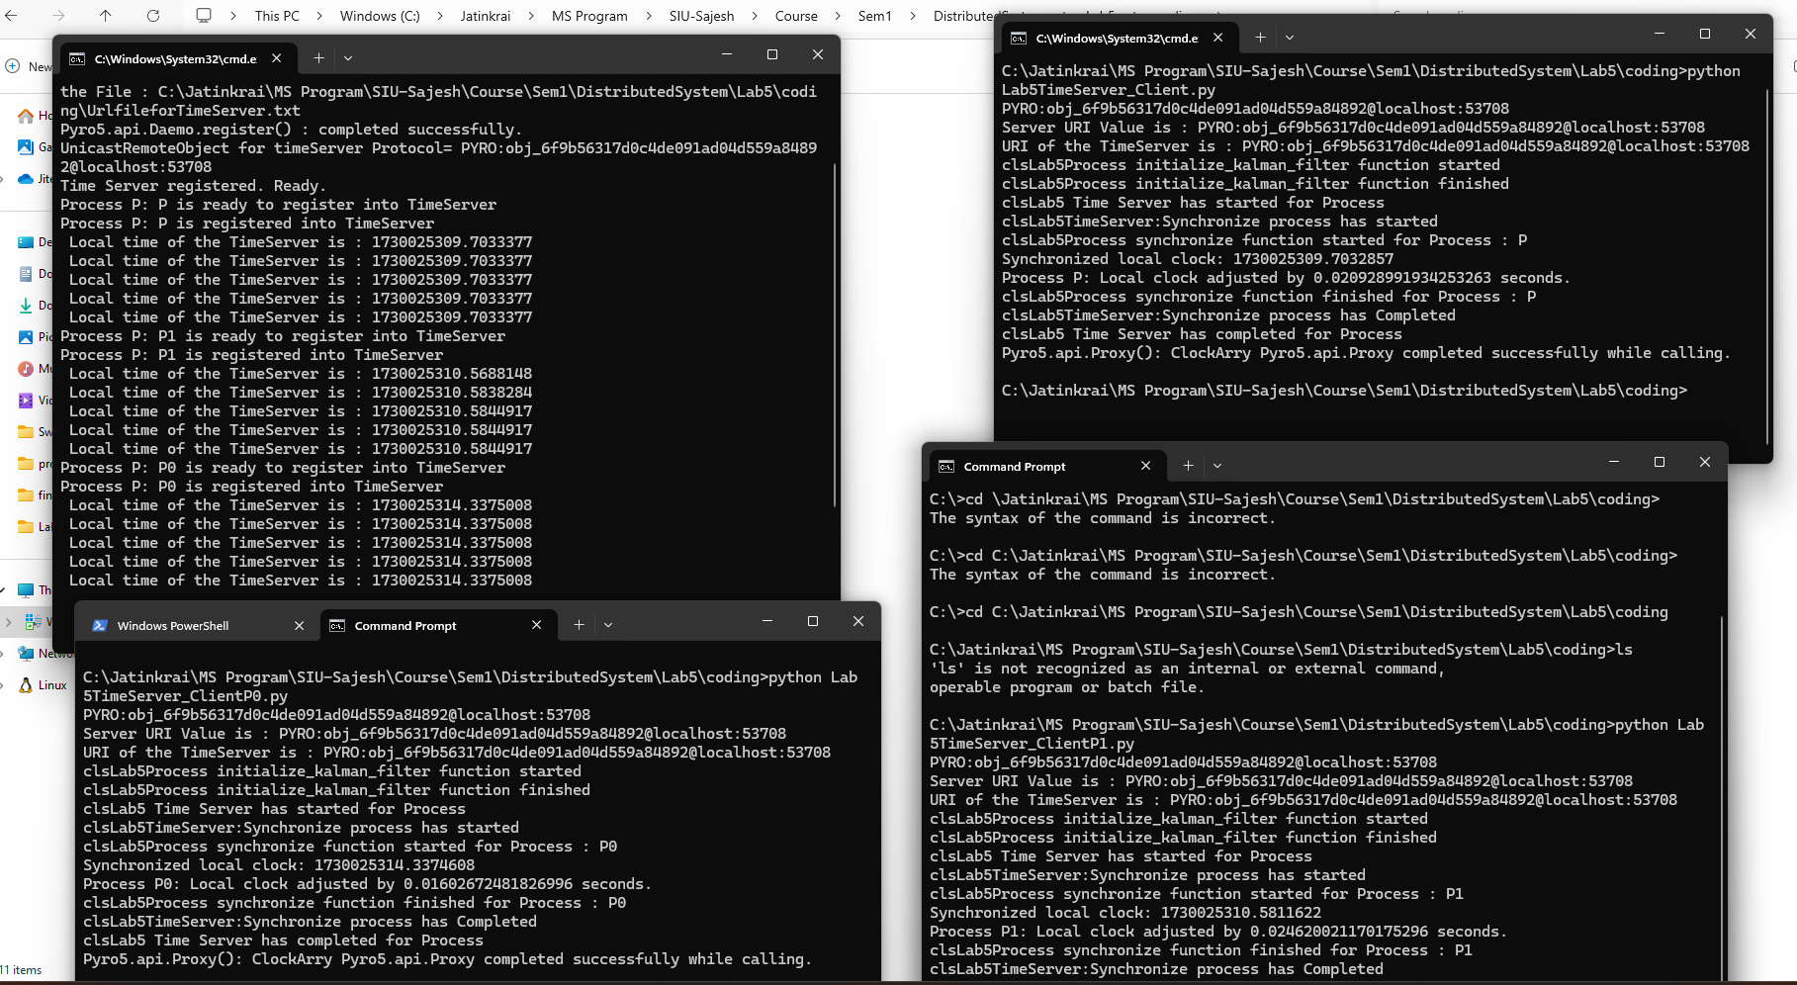

Slide 24
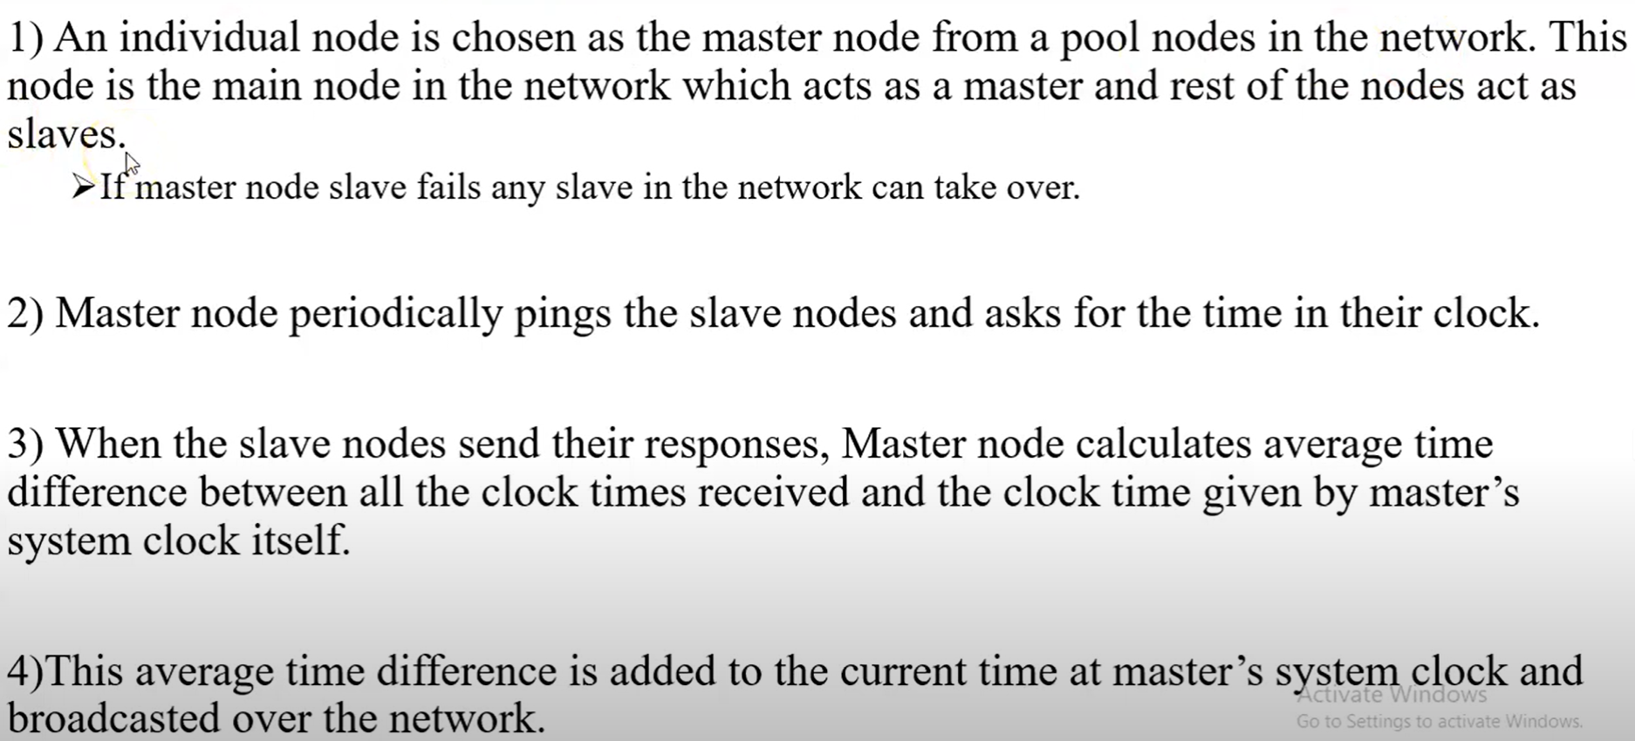
Notes:
https://www.youtube.com/watch?v=8NW7-6Ea59Y&t=11s

Slide 25
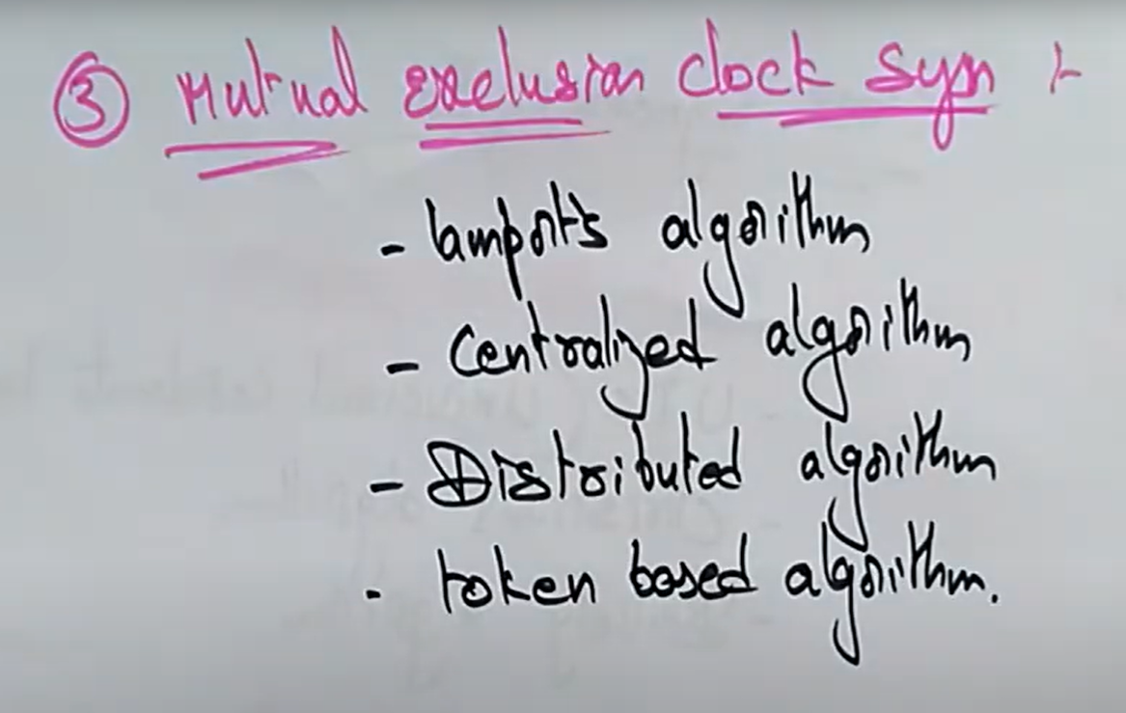
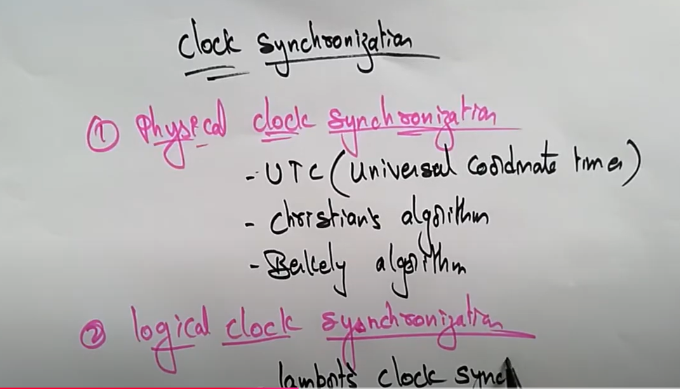
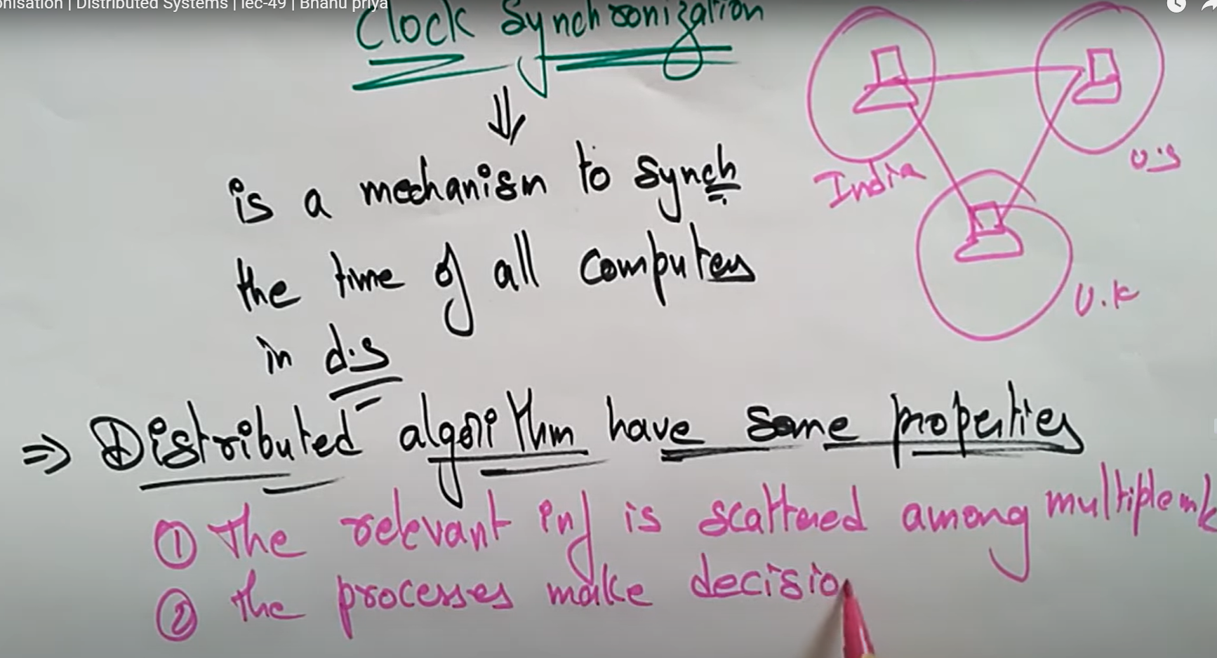

Slide 26
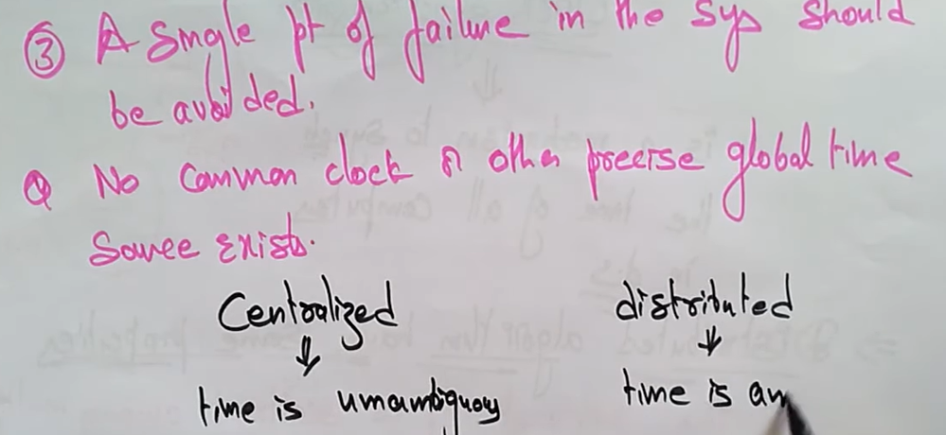
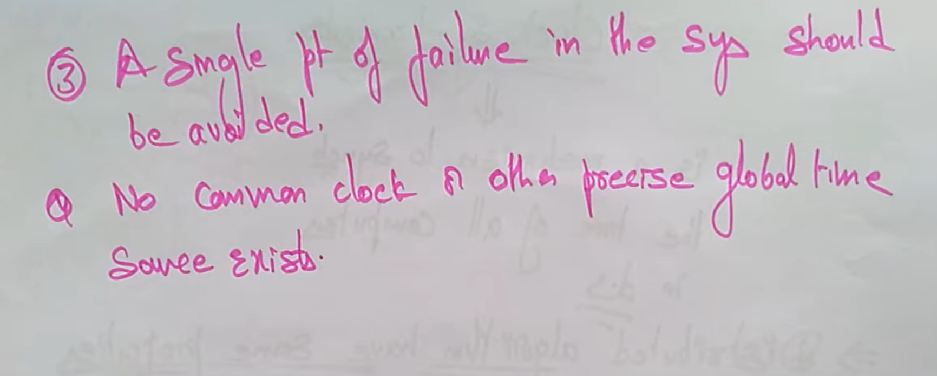
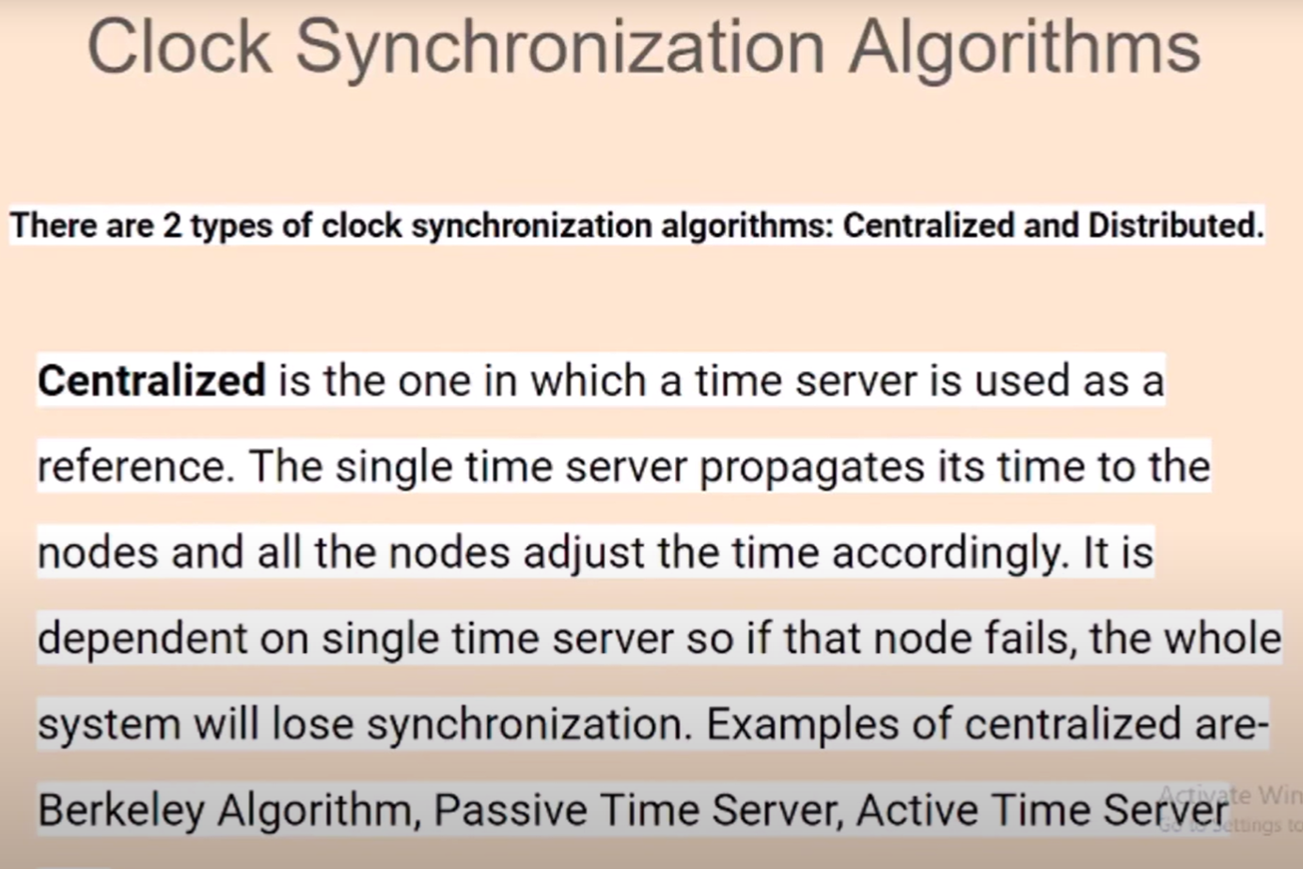
Problem Statement:-
To Implement Centralized Clock Synchronization using RMI (Remote method invocation).
Notes:
Berkeley algorithm, Passive Time Server , Active Time Server

Slide 27
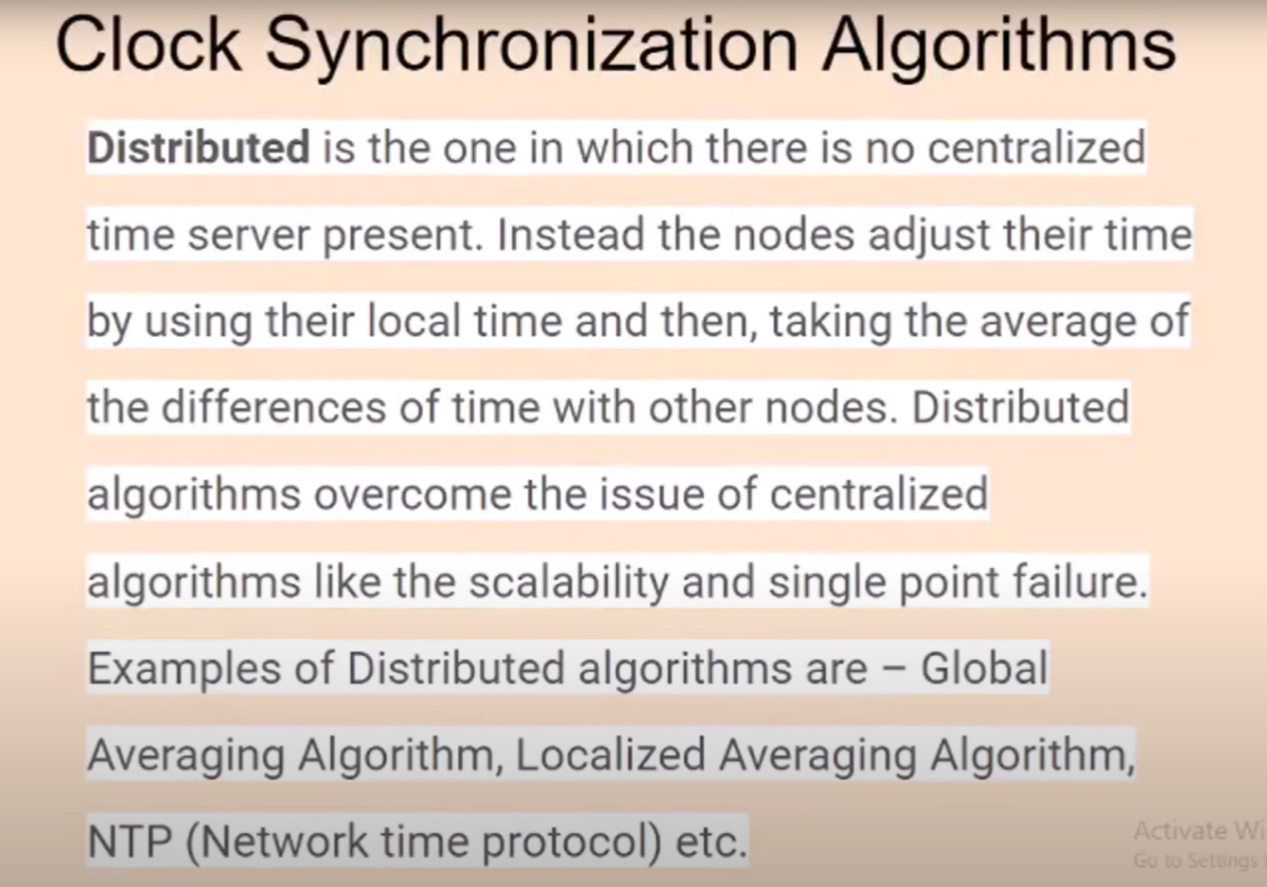
Problem Statement:-
To Implement Centralized Clock Synchronization using RMI (Remote method invocation).

Slide 28
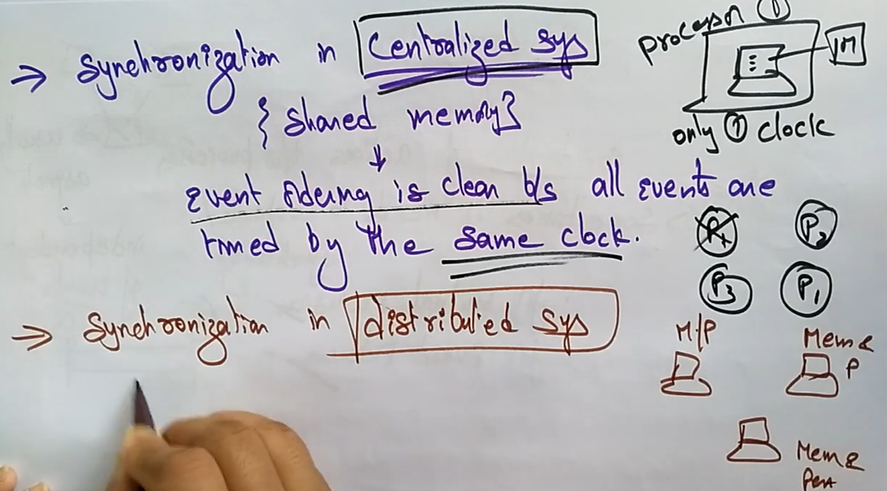
Problem Statement:-
To Implement Centralized Clock Synchronization using RMI (Remote method invocation).

Slide 29
